Slide 1


Slide 2
Unemployment Rate Predictor
AI Boot Camp Project 1
Team Members:
Jaidev Kler, Grigoriy Isayev, Ethan McManus, Ian Cody, Emmanuel Charles, Kyle Prudente
Notes:
Goal of the project is to answer a question: "How do interest rates, the Federal Funds Rate, and the effects of the pandemic compare to unemployment rates, and will unemployment decrease or rise when considered alongside inflation?"

Slide 3
Project Overview
Project Purpose / Description
A stable economy rests upon the foundations of low unemployment, consistent inflation rates, and steady interest rates.
The project aims to answer the question: The Federal Reserve is poised to decrease the Fed Funds Rate (commonly referred to as Interest Rates), as the PCE Inflation rate continues to get closer to their target range of 2 percent. What will this meant for unemployment at the state-level?
Notes:
Unemployment: Low unemployment rates are a hallmark of a thriving economy. This suggests that most people who are willing and able to work can find jobs. A low unemployment rate typically ranges between 3% to 5%, though this can vary depending on the location and economic context.
Inflation: Stable and moderate inflation is another key characteristic of a successful economy. Central banks often aim for an inflation rate of around 2% per year. This level is considered low enough to maintain purchasing power while also indicating healthy demand for goods and services.
The Federal Funds Rate is a critical economic indicator in the United States. It is the interest rate at which banks lend reserve balances to other depository institutions overnight on an uncollateralized basis. This rate is set by the Federal Open Market Committee (FOMC) of the Federal Reserve and serves as a primary tool for U.S. monetary policy.
Growth Rates: A successful economy typically exhibits a healthy and sustainable growth rate in its Gross Domestic Product (GDP). This growth should be steady, avoiding extreme fluctuations that could indicate underlying economic instability.

Slide 4
Project Overview
Approach taken to achieve goals
Analyze the correlation between unemployment and inflation.
Examine the correlation between unemployment and interest rates.
Use Prophet to forecast unemployment based on assumptions of lower interest rates and inflation.
Notes:
Correlations between Unemployment & Inflation
Correlation between Unemployment & Interest Rates
Forecasting Unemployment with Prophet:

Slide 5
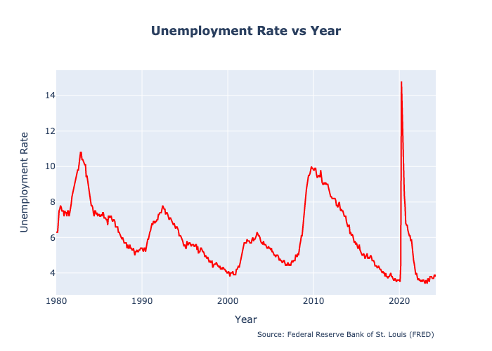
Unemployment Rate
Summary of the results with the supporting visualizations:
Taking a look at the US Unemployment Rate
Data from the Federal Reserve Bank of St. Louis for the United States
Spans from 01/1980 - 03/2024
Outliers
Early 1980’s
The 2008 Housing Market Collapse
COVID-19 Pandemic

Slide 6
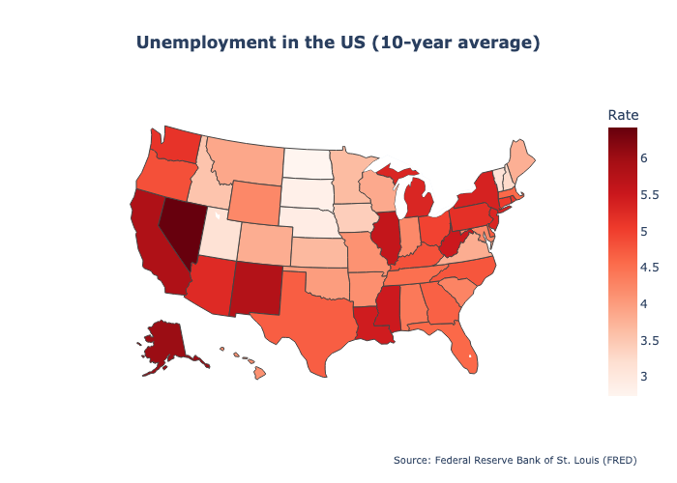
Unemployment Rate State Heat Map
Taking a look at the State Unemployment Rate
We decided to focus on unemployment rate over the last 10 years
5 states with the highest unemployment: Nevada, Alaska, California, New Mexico, Illinois
5 states with the lowest unemployment: North Dakota, South Dakota, Nebraska, Vermont, Utah

Slide 7
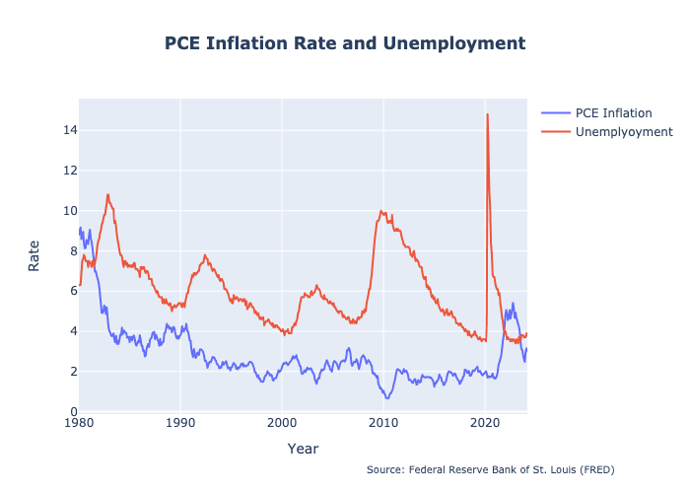
Inflation Rate vs. Unemployment
Unemployment and Inflation: Examining the relationship between unemployment and inflation rates reveals an intriguing connection. Historically, when inflation rates experience a decline, there's often a corresponding decrease in unemployment levels. This correlation becomes even more pronounced when analyzing data from the past two years, suggesting a nuanced interplay between economic factors.
How does the Fed balance the state of the economy
The Feds control the inflation by controlling the interest rate.
Full employment level of equilibrium refers to the situation where aggregate demand is equal to the aggregate supply when there is full employment in the economy.

Slide 8
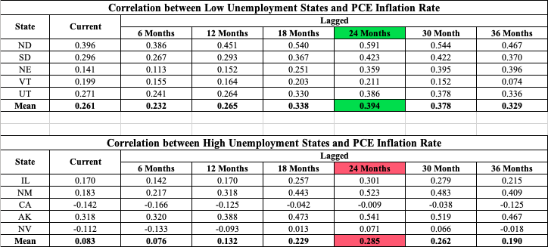
Inflation Rate Correlation

Slide 9
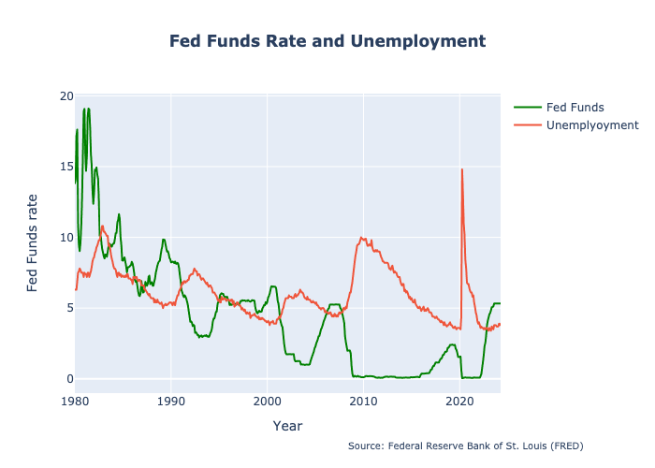
Fed Funds Rate vs. Unemployment
Unemployment and Fed Funds Rate
Exploring the dynamics between unemployment and the Federal Reserve's interest rate, known as the Fed Funds Rate, uncovers intriguing insights.
Notably, when the Federal Reserve opts to lower interest rates, there tends to be a subsequent decrease in unemployment rates.
This pattern becomes particularly evident when considering historical unemployment trends and their correlation with past adjustments to the Fed Funds Rate.
Notes:
What is Fed Funds rate?
Talk about the visualization -> Historically, as the Federal Reserve’s interest rate adjusts, the unemployment rate follows suit in the same direction. We can infer just on the visualization there is a positive correlation.

Slide 10
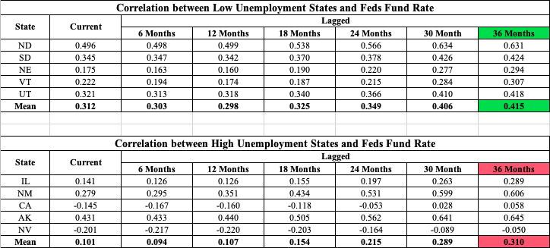
Fed Funds Rate Correlation
Correlation Between Unemployment and Fed Funds Rate
The unemployment rate does not immediately adjust to the interest rate.
While calculating the correlation between unemployment and the interest rate for states with the highest and lowest unemployment rate for multiple lagged months, we found that the strongest correlation comes after a 36 month lag.
There is a moderately positive correlation between unemployment and interest rate as there are still other factors that affect unemployment.
Notes:
The unemployment rate does not immediately adjust to the Fed Funds Rate, but there seems to be a 36 month lag. After we calculated the correlation between the Feds Fund Rate and the state with highest and lowest unemployment rate for multiple lagged months, we found that the strongest correlation is for the 36 month lag.

Slide 11
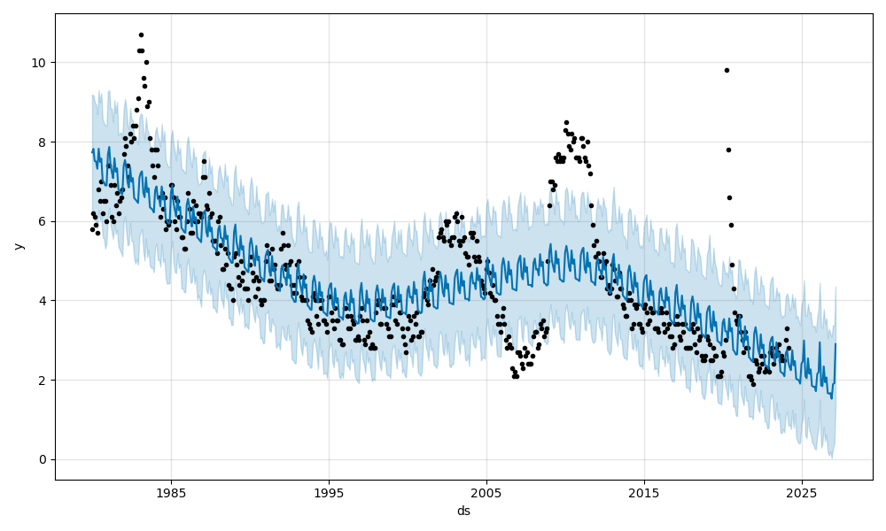
Forecasting the Future of Unemployment
Prophet Model:
Using advanced forecasting techniques like the Prophet model helps predict future unemployment trends. The model forecasts a decline in unemployment rates across all states for the next 36 months. This analysis offers valuable insights into potential economic changes and supports strategic decision-making.

Slide 12
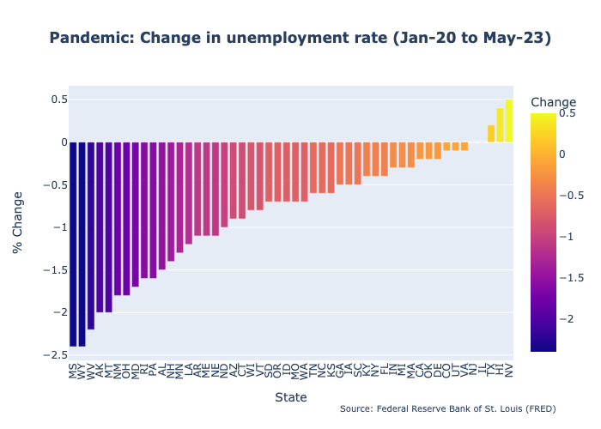
COVID-19 Pandemic Analysis
Pandemic Analysis:
Our analysis of the pandemic's impact on unemployment shows significant findings, especially in hard-hit states like Nevada. Despite efforts to recover, Nevada still struggles with high unemployment, highlighting the ongoing economic challenges from the pandemic.

Slide 13
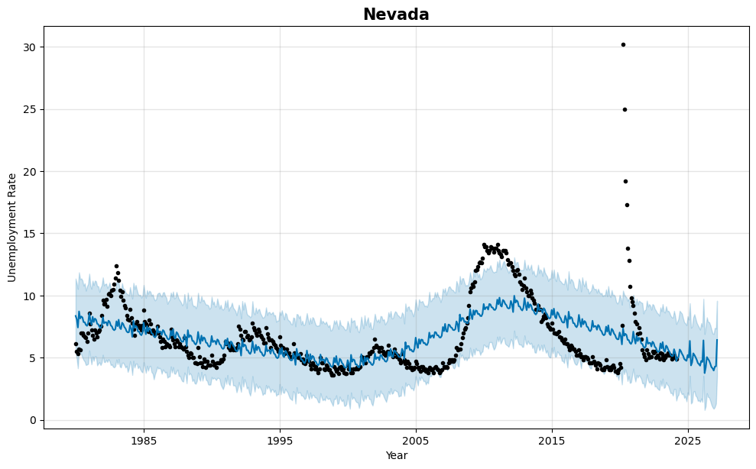
Forecasting the Future - Nevada
Prophet analysis for Nevada:
Our data indicates that the unemployment rate in Nevada, which was the hardest hit by the pandemic, will decrease in the coming years. This positive trend reflects the state's ongoing economic recovery and growth.

Slide 14
Summary
All three analysis show a trend that unemployment will continue to fall. The lagged trends showed a higher correlation.
Unemployment and PCE inflation
Unemployment and Fed Funds rate
Prophet Model
Pandemic analysis was carried based on the anomalies seen in the data (California and Nevada). This analysis revealed that some states including Nevada had still not recovered from the pandemic.

Slide 15
Finalizing the topic and getting a large enough dataset
Merges on Git
Problems Encountered

Slide 16
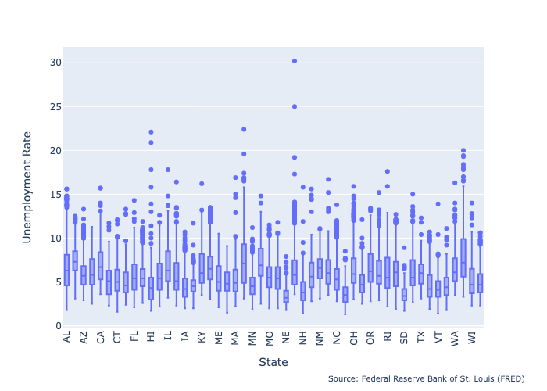
There are a lot of factors that affect unemployment. Our analysis is the first step towards exploring the unemployment trend. A more in-depth analysis might be able to provide answers for anomalies like California.
Outlier period like the pandemic could be omitted from the calculations to provide a better forecast for the future.
Text
Future Considerations

Slide 17
Thank You

